Slide 1
Detection of Parkinson’s Disease
By Tushar singh

Slide 2
What is Parkinson?
Parkinson's disease is a neurodegenerative disorder that primarily affects movement.
It occurs when nerve cells (neurons) in the brain that produce dopamine, a chemical messenger responsible for smooth and coordinated muscle movements, become impaired or die.
This leads to symptoms such as tremors, stiffness, slowness of movement, and difficulties with balance and coordination.
Parkinson's disease is chronic and progressive, meaning it worsens over time, but treatments are available to help manage its symptoms.

Slide 3
Data
A data and Excel file containing 195 rows and 24 columns.
COLUMNS:
name
MDVP:Fo(Hz)
MDVP:Fhi(Hz)
MDVP:Flo(Hz)
MDVP:Jitter(%)
MDVP:Jitter(Abs)
MDVP:RAP
MDVP:PPQ
Jitter:DDP
MDVP:Shimmer
MDVP:Shimmer(dB)
Shimmer:APQ3
Shimmer:APQ5
MDVP:APQ
Shimmer:DDA
NHR
HNR
status
RPDE
DFA
spread1
spread2
D2
PPE

Slide 4
Understanding Columns
MDVP - Multidimensional Voice Programme (average rate at which vocal cords vibrate).
MDVP:Fo(Hz) - average rate at which vocal cords vibrate, measured in hertz
MDVP: Fhi(Hz) - highest rate at which vocal cords vibrate,
MDVP: Flo(Hz) - lowerst rate at which vocal cords vibrate,
MDVP: Jitter(%) -indicates degree of irregularity in the vocal cord vibrations, which can affect the smoothness of speech.
MDVP: Jitter(Abs) -absolute difference between consecutive periods of the fundamental frequency, measured in microseconds.
MDVP: RAP - "Relative Average Perturbation" calculated based on the average difference between consecutive periods of the fundamental frequency, expressed as a percentage.
MDVP: PPQ - "Five-Point Period Perturbation Quotient" calculated based on the average absolute difference between consecutive periods of the fundamental frequency, expressed as a percentage.
Jitter: DDP - represents the average difference between jitter cycles, calculated in microseconds.

Slide 5
MDVP:Shimmer - measure of variation in the amplitude of the voice signal, which indicates the degree of irregularity or flutter in the vocal cord vibrations.
MDVP:Shimmer(dB) - This is the amplitude variation measured in decibels (dB), providing a more standardized measure of shimmer.
Shimmer:APQ3 - "Amplitude Perturbation Quotient" and is calculated based on the average absolute difference between consecutive amplitude peaks over a specified time interval (e.g., 3 milliseconds).
Shimmer:APQ5 - Similar to Shimmer:APQ3, but calculated over a longer time interval (e.g., 5 milliseconds), providing a measure of medium-term amplitude variation.
MDVP:APQ - Amplitude Perturbation Quotient" and is a measure of the average absolute difference between the amplitudes of consecutive periods of the voice signal.
Shimmer:DDA - represents the average difference between consecutive shimmer cycles, calculated in milliseconds.
NHR -
NHR (Noise-to-Harmonics Ratio): This is a measure of the ratio of noise to tonal components in the voice. It indicates the amount of noise present in the voice signal relative to the harmonic (tonal) components.
HNR (Harmonics-to-Noise Ratio): This is the inverse of NHR and represents the ratio of harmonic (tonal) components to noise in the voice. Higher values indicate a clearer, more harmonic-rich voice signal.

Slide 6
RPDE (Recurrence Period Density Entropy): This is a measure of the nonlinear dynamical complexity of the voice signal. It quantifies the rate of recurrence of patterns in the signal, reflecting its predictability and complexity.
D2 (Correlation dimension): This is another measure of the nonlinear dynamical complexity of the voice signal. It quantifies the number of independent degrees of freedom in the signal, providing insights into its underlying dynamics.
DFA (Detrended Fluctuation Analysis): This is a method used to analyze the fractal properties of the voice signal. DFA calculates the fractal scaling exponent, which describes how the fluctuation of the signal changes with the length of the observation window. It provides information about the long-range correlation properties of the signal.

Slide 7
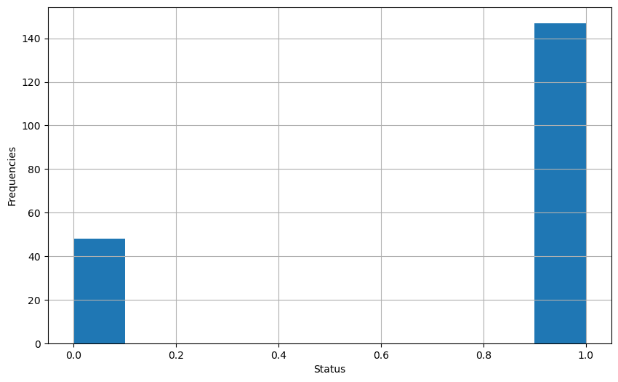
Status Histogram
0 represent healthy people
1 represent Parkinson
This chart shows that more people in data have Parkinson’s

Slide 8
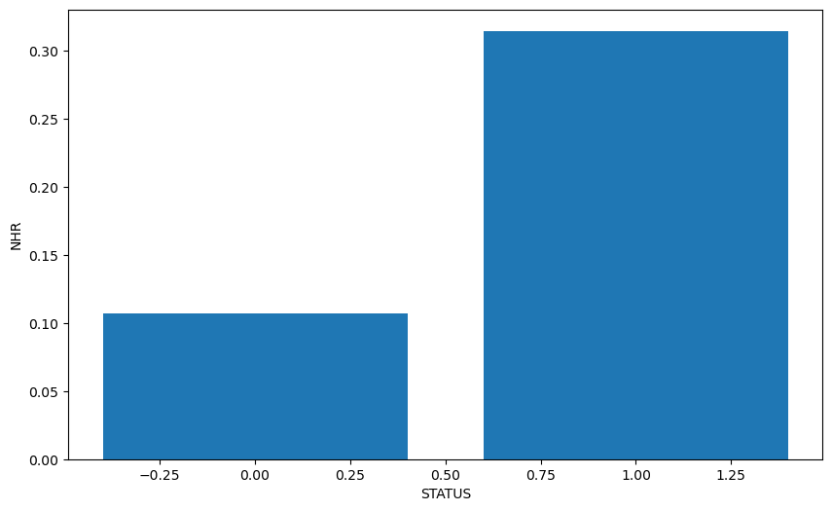
Status to NHR Bar Graph
This chart shows that status and NHR has positive correlation.
As people having high NHR have Parkinson

Slide 9
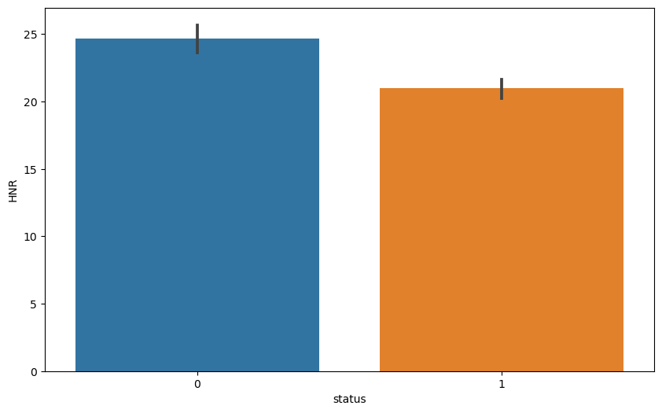
Status to HNR Bar Graph

Slide 10
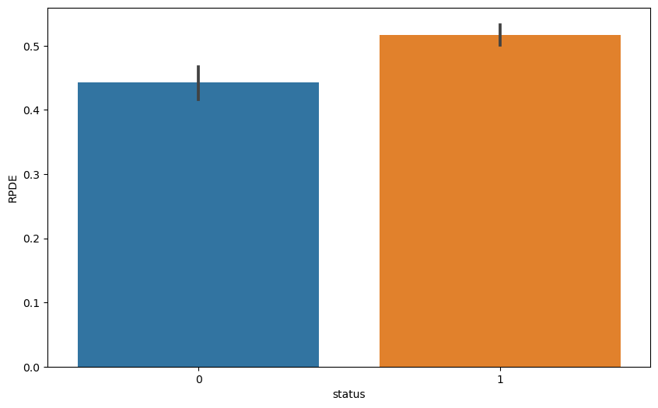
Status to RPDE Graph

Slide 11
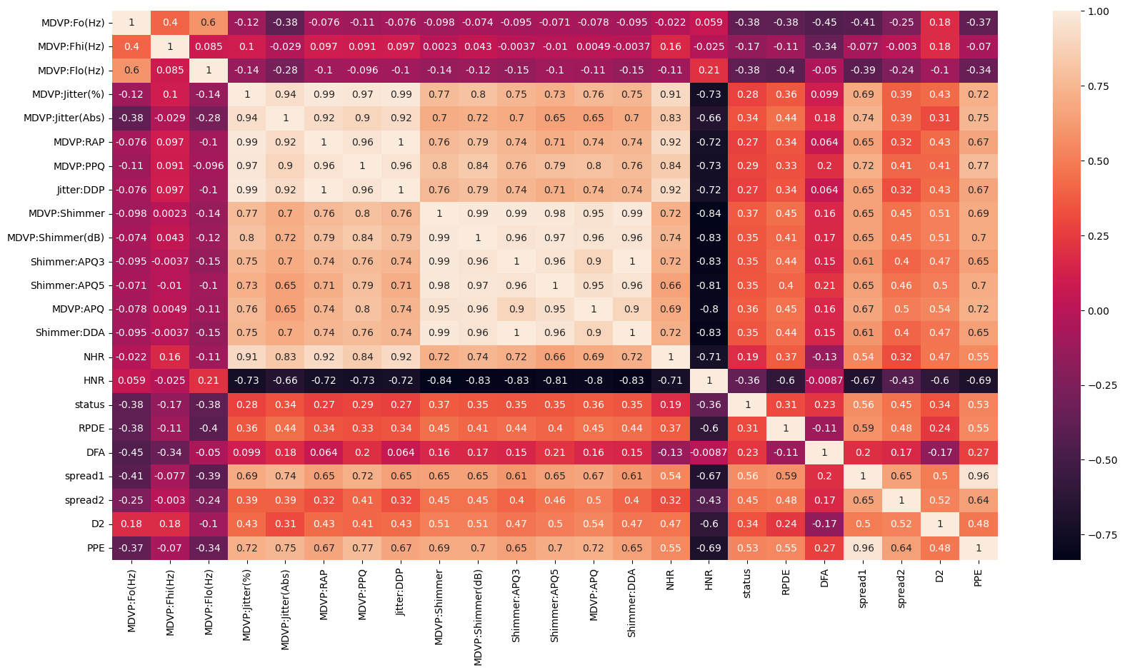
Heatmap

Slide 12
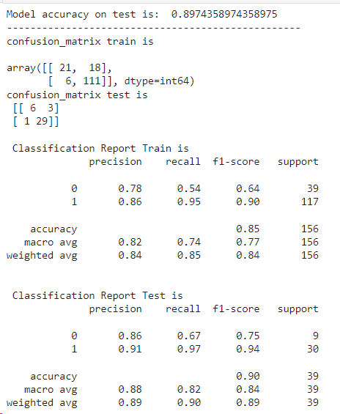
Logistic Regression Model
Modal accuracy on test is around 89%

Slide 13
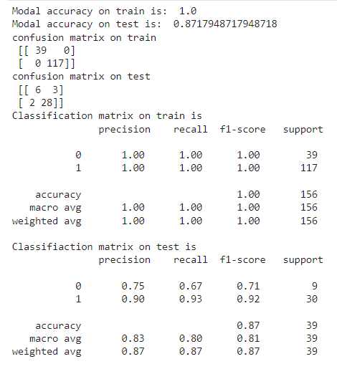
Random Forest Classifier
Modal accuracy on test is around 87%

Slide 14
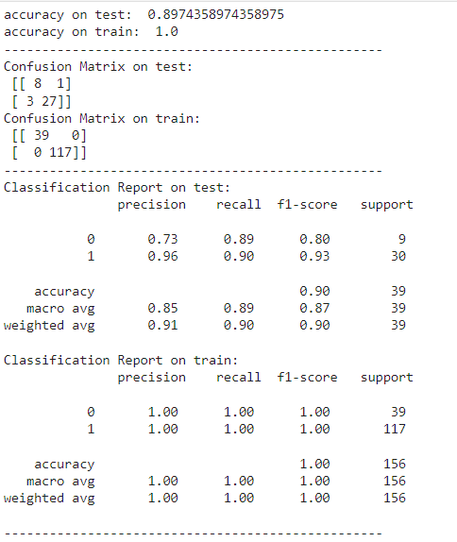
Decision Tree Classifier
Accuracy is around 89%

Slide 15
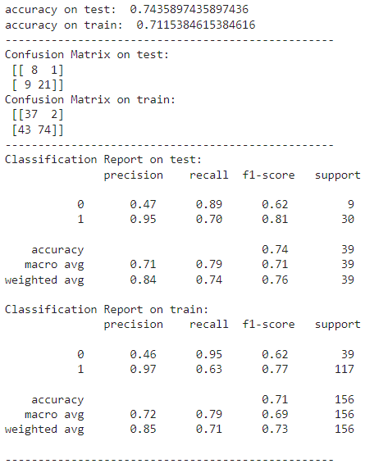
Naïve Bayes Gaussian NB
Accuracy on test is around 74%

Slide 16
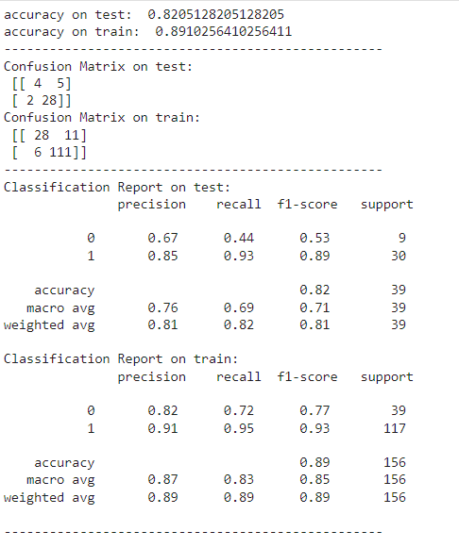
K Neighbors Classifier
Accuracy of modal is around 82%

Slide 17
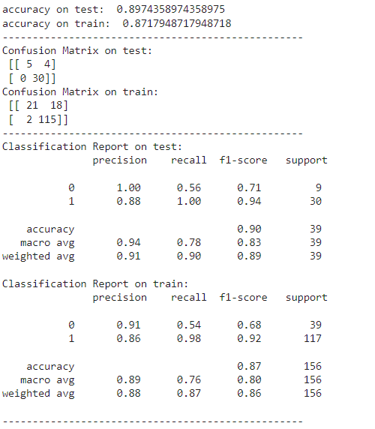
SVC
Accuracy is around 89%

